Slide 1
Aircraft risk assessment
Commercial and Private aircraft analysis
By Rahaman Yusuf

Slide 2
Business Expansion Goals
Exploring the potential of aircraft acquisition for portfolio expansion
Expanding into new industries and increasing diversification of company’s existing lines of business.
Analysis of aircraft by manufacturer and model
Understanding how the selection of aircraft may optimize our current method of transportation
Increase accuracy of preparation for entering into new industry
Attempt to identify the synergies that may arise from expansion of current portfolio

Slide 3
About Us
We currently are a multinational company that invest in several industries sectors. Due to our long-term vision of maintaining growth for our stakeholders, we aim to keep risk as low as possible while striving to select business lines that has shown a growth trends which closely aligns with global economic cycles.
Our latest expansion plans involves the purchase and acquisition of commercial and private aircrafts. Based on the outcome of our analysis, we will further proceed into qualifying which aircraft purchase combination strategy closely aligns with our current business strategy but also stay open to any potential evolution of our company that will further solidify our diversification of business’s that decreases our risk exposure, increases our profitability and streamlines our operations.

Slide 4
Method of Analysis
Our approach to this analysis involves using publicly available data that has been collected over a period of 62 years (from 1962 to 2024) by the National Transportation Safety Board (NTSB) and is available on there aviation accident database.
Statistical methods and Technologies used in this analysis will mainly be derived from the use of python programming language, pandas which is an open-source python library for data analysis and manipulation.
We will also convey our findings with the use of visual representation of data and their relations in order to easily gain insight and make business decisions based on reliable information as much as possible. The visual representation will be created with another well known and reliable python library known as matplotlib. This technology allows its user to create static and interactive visualizations

Slide 5
Analysis
We are concerned with answering the following questions:
which commercial aircraft has the highest and lowest risk
which private aircraft has the highest and lowest risk
what is the the survival rate of passengers on each type of aircraft
which manufacturer makes the lowest risk aircraft

Slide 6
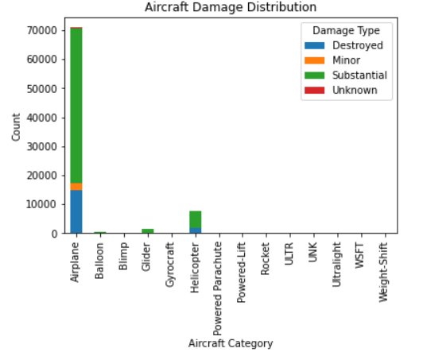
which commercial aircraft has the highest and lowest risk
Based on the analysis done on the available dataset, Airplanes have the highest risk. Risk is defined by Damage type which consist of three sub categories listed in order of most to least damage
Substantial
Destroyed
Minor

Slide 7
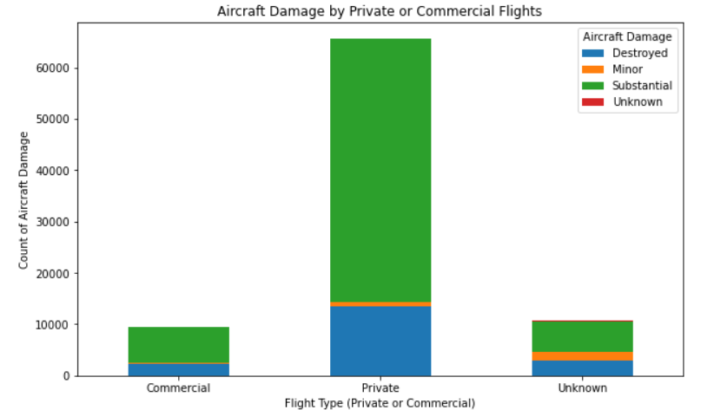
which private aircraft has the highest and lowest risk
Based on dataset, private and commercial use case has been attained by categorizing a ‘Purpose of use column’ between private and commercial. For example, personal, business, corporate were considered private. And ferry, aerial observation, banner tow were considered commercial.
Private use has the highest damage rate compared to commercial

Slide 8
which manufacturer makes the lowest risk aircraft
The dataset does not have data based on manufacturer directly, but does have data on make and model. These two fields can closely give us the answer we are looking for. Within this dataset there are too many makes so the number of engines were used as a substitute. It turns out that the single engine airplanes have the highest number of injuries. The dual engine airplanes are second place for this metric. This information shows that the dual engine aircraft is a better choice

Slide 9
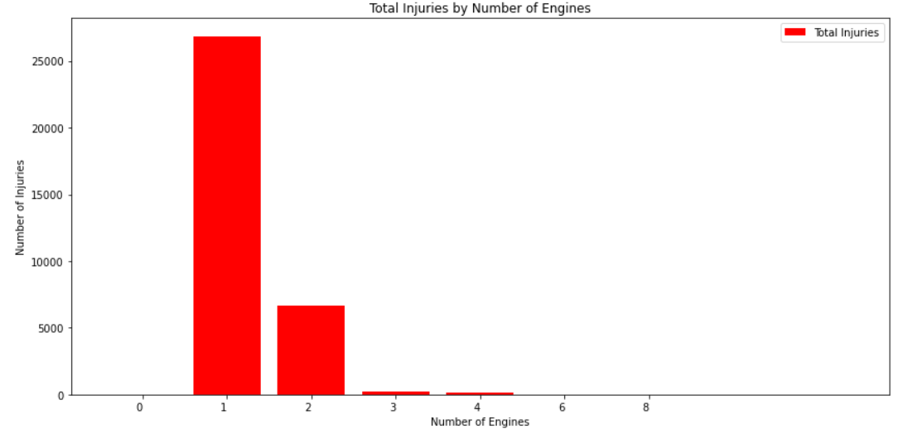
Total injuries by Number of Engines

Slide 10
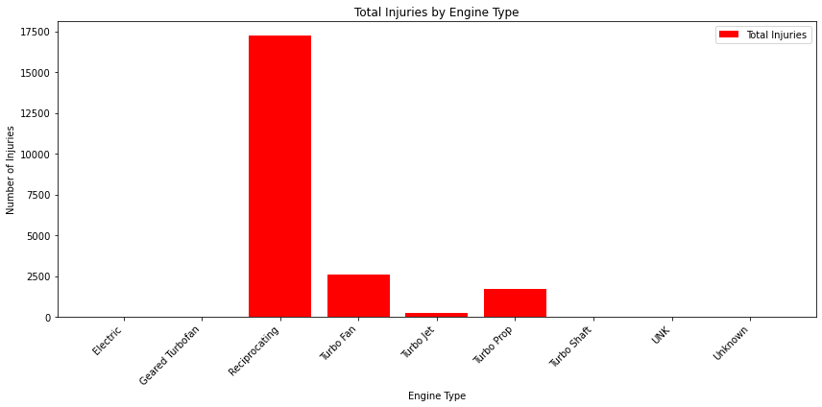
What engine type is the safest

Slide 11
what is the survival rate of passengers on each type of airplane Model
Ultimately. The preservation of life is the most important metric that we should be concerned about. On the next slide shows the percentile distribution and what airplane models are in each percentile. From the 90-99% and the 100% should be the ones considered.

Slide 12
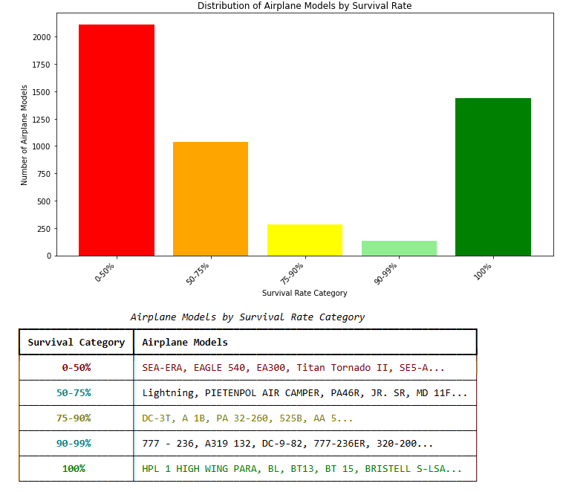
Survival rate by Models

Slide 13
Conclusion
Our analysis shows that the safest aircrafts for our business has the following features and combinations:
Airplane
Dual engine
Jet propulsion
Models:
777-236, A319, DC-9-82, 777-236ER, 320-200
HPL 1 High Wing PARA, BL, BT13, BT 15, BRISTELL S-LSA
*this is a short list of models that fall into our category.

